Slide 1

Extracting Common Inference Patterns from Semi-Structured Explanations
Sebastian Thiem
Peter Jansen
Notes:
Good afternoon everyone!
My name is Sebastian and I’m a freshly minted graduate student over at the University of Arizona
After graduation I spent the summer working with Peter Jansen and our focus was on trying to extract inference patterns from the explanations to science questions
In this paper we present the results of that work
Lets get started

Slide 2
Our long term interests focus on creating algorithms that aggregate large amounts of data from multiple sources and knowledge bases into human readable explanations
Notes:
Our long term interest is to design algorithms that aggregate multiple facts from different knowledge bases into human readable explanations
This aggregation of facts we refer to as multihop inference,
as the model will need to make multiple hops throughout the knowledge bases in order to combine these facts

Slide 3
Our long term interests focus on creating algorithms that aggregate large amounts of data from multiple sources and knowledge bases into human readable explanations
We need on average 4-6 facts for an explanation with some needing 16+ facts ¹
¹ Jansen. 2018. Multi-hop inference for sentence level textgraphs: How challenging is meaningfully combining information for science question answering? TextGraphs.
Notes:
When writing explanations for elementary science questions for example
We find that on average we need to aggregate 4-6 facts per explanation, even up to 16+ facts in some cases

Slide 4
Our long term interests focus on creating algorithms that aggregate large amounts of data from multiple sources and knowledge bases into human readable explanations
We need on average 4-6 facts for an explanation with some needing 16+ facts ¹
Current models can determine 2-3 relevant facts before falling off due to sematic drift ²
¹ Jansen. 2018. Multi-hop inference for sentence level textgraphs: How challenging is meaningfully combining information for science question answering? TextGraphs.
² Jansen. 2017. A study of automatically acquiring explanatory inference patterns from corpora of explanations: Lessons from elementary science exams. In 6th Workshop on Automated Knowledge Base Construction
Notes:
Sadly, the current models are generally only capable of performing 2-3 hops before the facts they gather are no longer helping in the explanations
An issue we refer to as semantic drift

Slide 5
Our long term interests focus on creating algorithms that aggregate large amounts of data from multiple sources and knowledge bases into human readable explanations
We need on average 4-6 facts for an explanation with some needing 16+ facts ¹
Current models can determine 2-3 relevant facts before falling off due to sematic drift ²
Patterns found in question explanations hold information about common inferences needed to explain questions
¹ Jansen. 2018. Multi-hop inference for sentence level textgraphs: How challenging is meaningfully combining information for science question answering? TextGraphs.
² Jansen. 2017. A study of automatically acquiring explanatory inference patterns from corpora of explanations: Lessons from elementary science exams. In 6th Workshop on Automated Knowledge Base Construction
Notes:
In order to address this problem, we have chosen to extract patterns of inference from question explanations
Hypothesizing that in doing so we could focus the knowledge aggregation with the types of connections found in the explanations
Let me show you what I mean

Slide 6
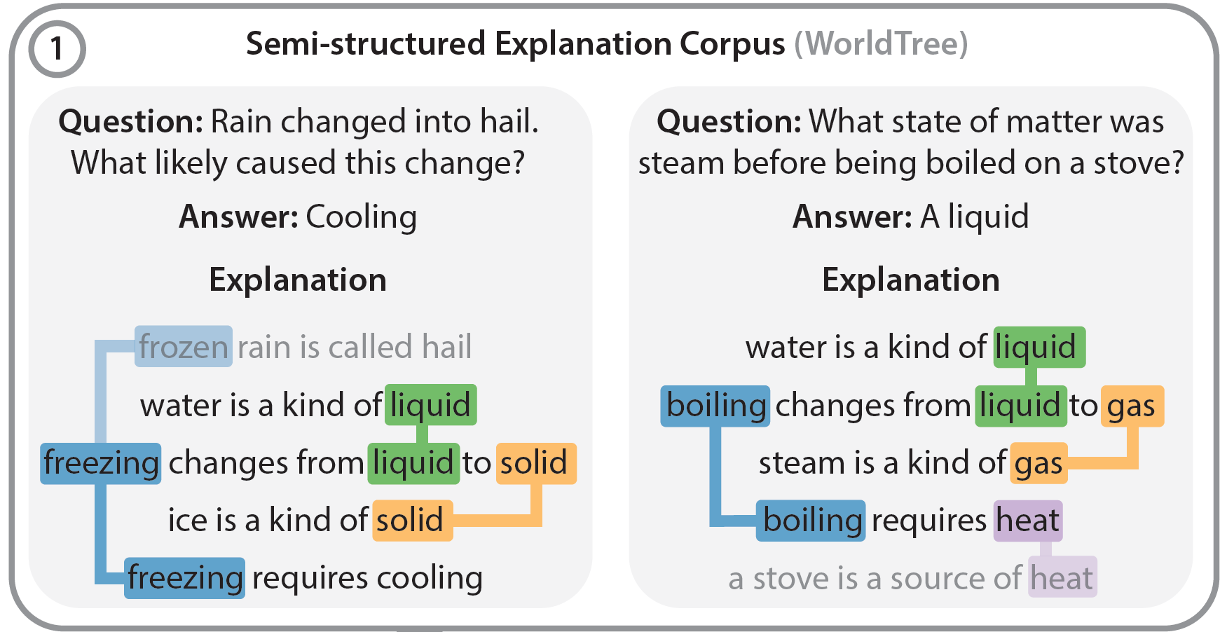
Notes:
Here we have two answered questions from the 4th grade science exams, followed by an explanation
The first question:
Rain changed into Hail. What likely caused this change
Cooling.
Now why is it cooling?
Well, because:
…
This is the kind of human readable explanation we want to see from our models.
Now: When we look over at this other question about boiling
we see the same kinds of facts being connected in the same ways
Only now the water is being boiled rather than frozen

Slide 7
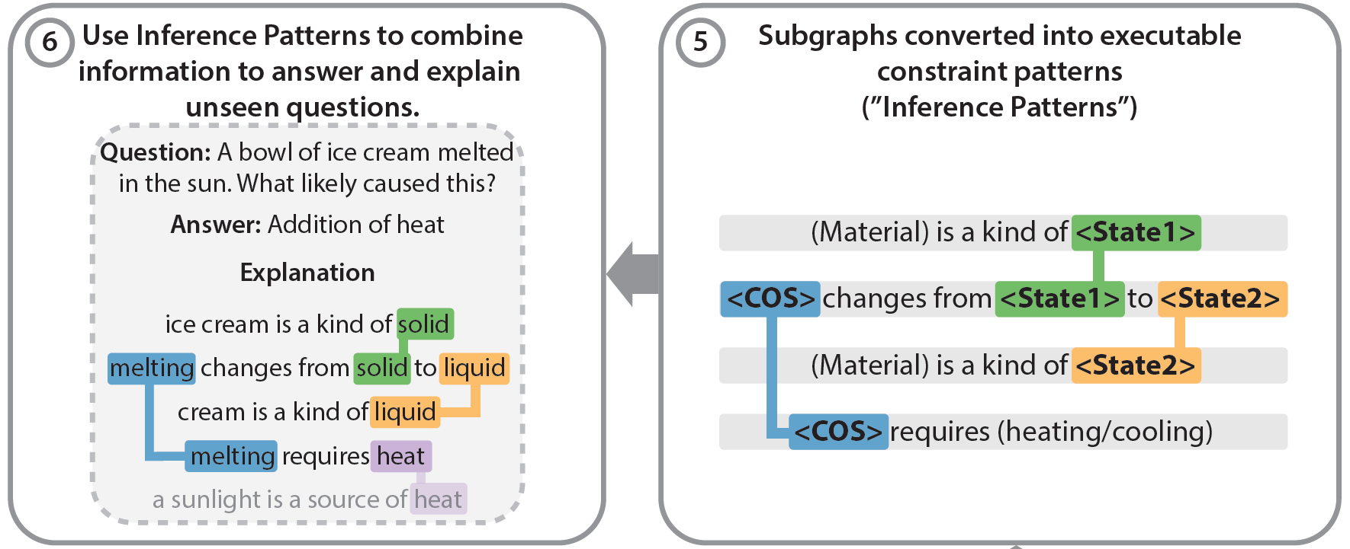
Notes:
In the literature you would often call these Semantic Frames or Schema, but we refer to them as “inference patterns”
The essence of these patterns focuses on the connections from one fact to another
And we can imagine other facts fitting into these constraints
For example

Slide 8
Notes:
This idea of melting
So Just by observing patterns in explanations about Freezing and Boiling we were able to populate a brand new explanation about melting
Now, this may be a toy example, but I would like to point out that currently; being able to aggregate 4 facts like this, is not something our models can do.
So, how should we go about extracting these patterns from the corpus
Initially we had piloted experiments that would allow us to extract these automatically
By doing this automatically we produced a lot of patterns very quickly, however the quality of these patterns was too low for us to be able to use them
There are a few issues with trying to approach the problem this way and I would like to go over some now

Slide 9
Issue 1
Sparsity in Explanation Annotation
Fact 1 --
Fact 2 --
Friction occurs when two object’s surfaces move against each other
As an object’s smoothness increases, it’s friction will decrease when it’s surface moves against another surface
Issue:
These facts are never used together in the corpus of explanations
Notes:
Issue 1: sparsity
Here we have two facts, <read facts>
Now, we could see these being used together in an explanation
<next slide>

Slide 10
Issue 1
Sparsity in Explanation Annotation
Fact 1 --
Fact 2 --
Friction occurs when two object’s surfaces move against each other
As an object’s smoothness increases, it’s friction will decrease when it’s surface moves against another surface
Issue:
These facts are never used together in the corpus of explanations
Notes:
Something like comparing the friction of a smooth rock and a rough rock

Slide 11
Issue 1
Sparsity in Explanation Annotation
Fact 1 --
Fact 2 --
Friction occurs when two object’s surfaces move against each other
As an object’s smoothness increases, it’s friction will decrease when it’s surface moves against another surface
Issue:
These facts are never used together in the corpus of explanations
Notes:
but

Slide 12
Issue 1
Sparsity in Explanation Annotation
Fact 1 --
Fact 2 --
Friction occurs when two object’s surfaces move against each other
As an object’s smoothness increases, it’s friction will decrease when it’s surface moves against another surface
Issue:
These facts are never used together in the corpus of explanations
Notes:
The automatic approach did not connect them because the training data didn’t use them together
An automated approach requires that a pattern be seen in the training data for it to be found
other wise it has no way of knowing that the facts could be together
This sparsity results in an incomplete recall of the patterns in the corpus
Another issue is

Slide 13
Issue 2
Permissiveness in Automatically Populating Edges
Fact 1 --
Fact 2 --
Melting means changing from a solid to a liquid by adding heat energy
Wax is an electrical energy insulator
Issue:
These facts will connect on shared words, but that connection is not meaningful
Notes:
Permissiveness
Here we have <read facts>
We can imagine a pattern that talks about melting wax using both of these facts, but ultimately
We want to generalize that pattern to talk about other things melting, not all of them insulators
However the automated approach draws a constraint here on the shared word energy
This over constrains the pattern to only apply to electrical insulators, and it would never know that other things are capable of melting

Slide 14
Issue 2
Permissiveness in Automatically Populating Edges
Fact 1 --
Fact 2 --
Melting means changing from a solid to a liquid by adding heat energy
Wax is an electrical energy insulator
Issue:
These facts will connect on shared words, but that connection is not meaningful
Notes:
We need to remove that constraint on the pattern in order to achieve this
Due to these problems, we came to the conclusion that it would be beneficial to include a human in the detection and curation of these patterns
That’s why we built a tool to help bridge the gap and provide a methodical structure to the task of extracting these patterns
Let me show you the tool now

Slide 15
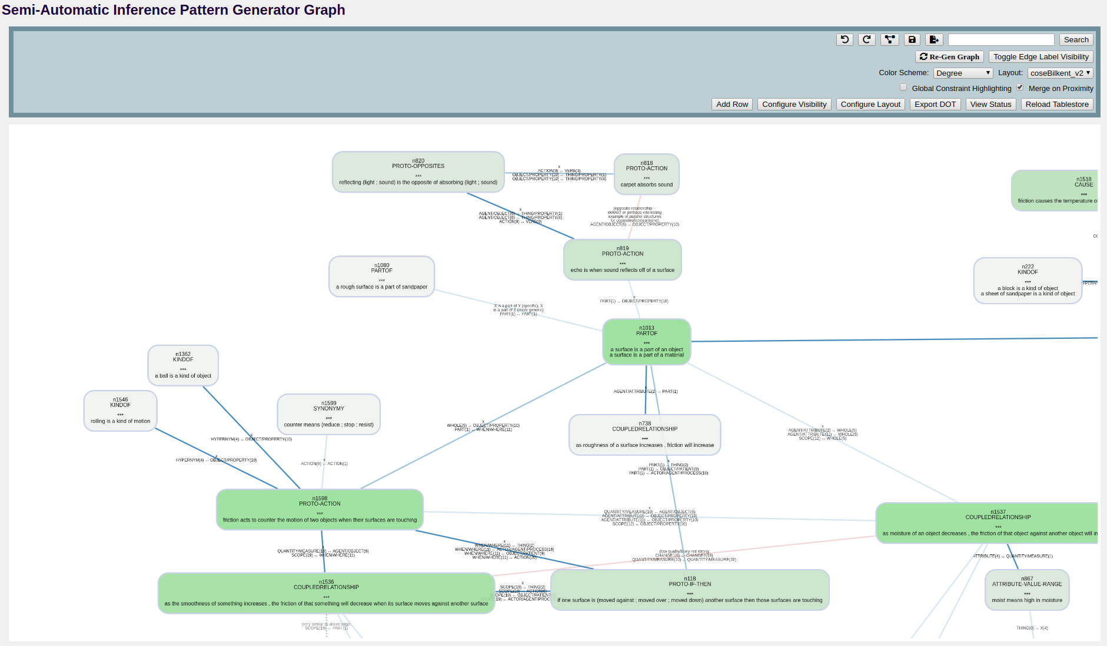
Tool Bar
Nodes
Edges
Multiple rows and constraints
Notes:
Since the graphical representation of these patterns seemed to resonate really well with us, we decided to use that as the catalyst for this tool
By treating the patterns as subgraphs embedded in a larger array of connections, we turn the task of pattern extraction into pattern matching and graph curation
Each node in this graph represents the possible facts from a table of facts that could satisfy the constraints on that node
And here the edges are those constraints applied to the node
Zooming out a bit…

Slide 16
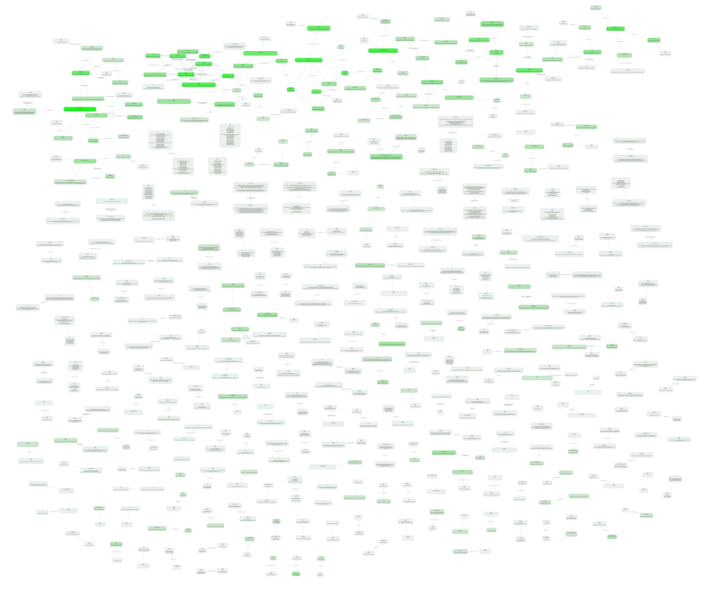
Before
Notes:
Here is the full graph generated by a high precision low recall heuristic
Clearly it needs work
We see some initial connections up at the top,
but the vast majority of it is just stray nodes and edges
So this is what we use the tool on to get…

Slide 17
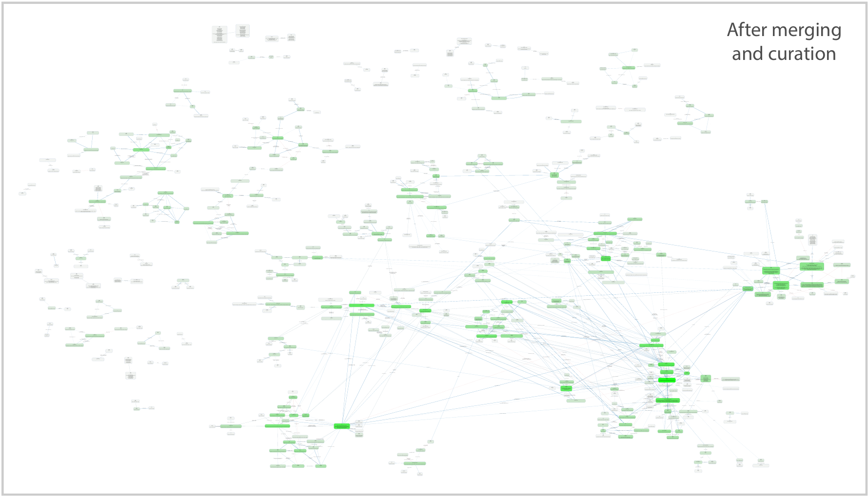
After
Notes:
This
Now we see the clusters of similar concepts grouping up in various places
This is a graph with clearly defined patterns in it
At this point the task we had left was just to go through and find them
Which, due to the clear segmentation of different concepts, had become rather easy in a lot of cases
Now, The task of using the tool itself is rather involved, but I would like to go through a high level overview in a short demo I have prepared

Slide 18
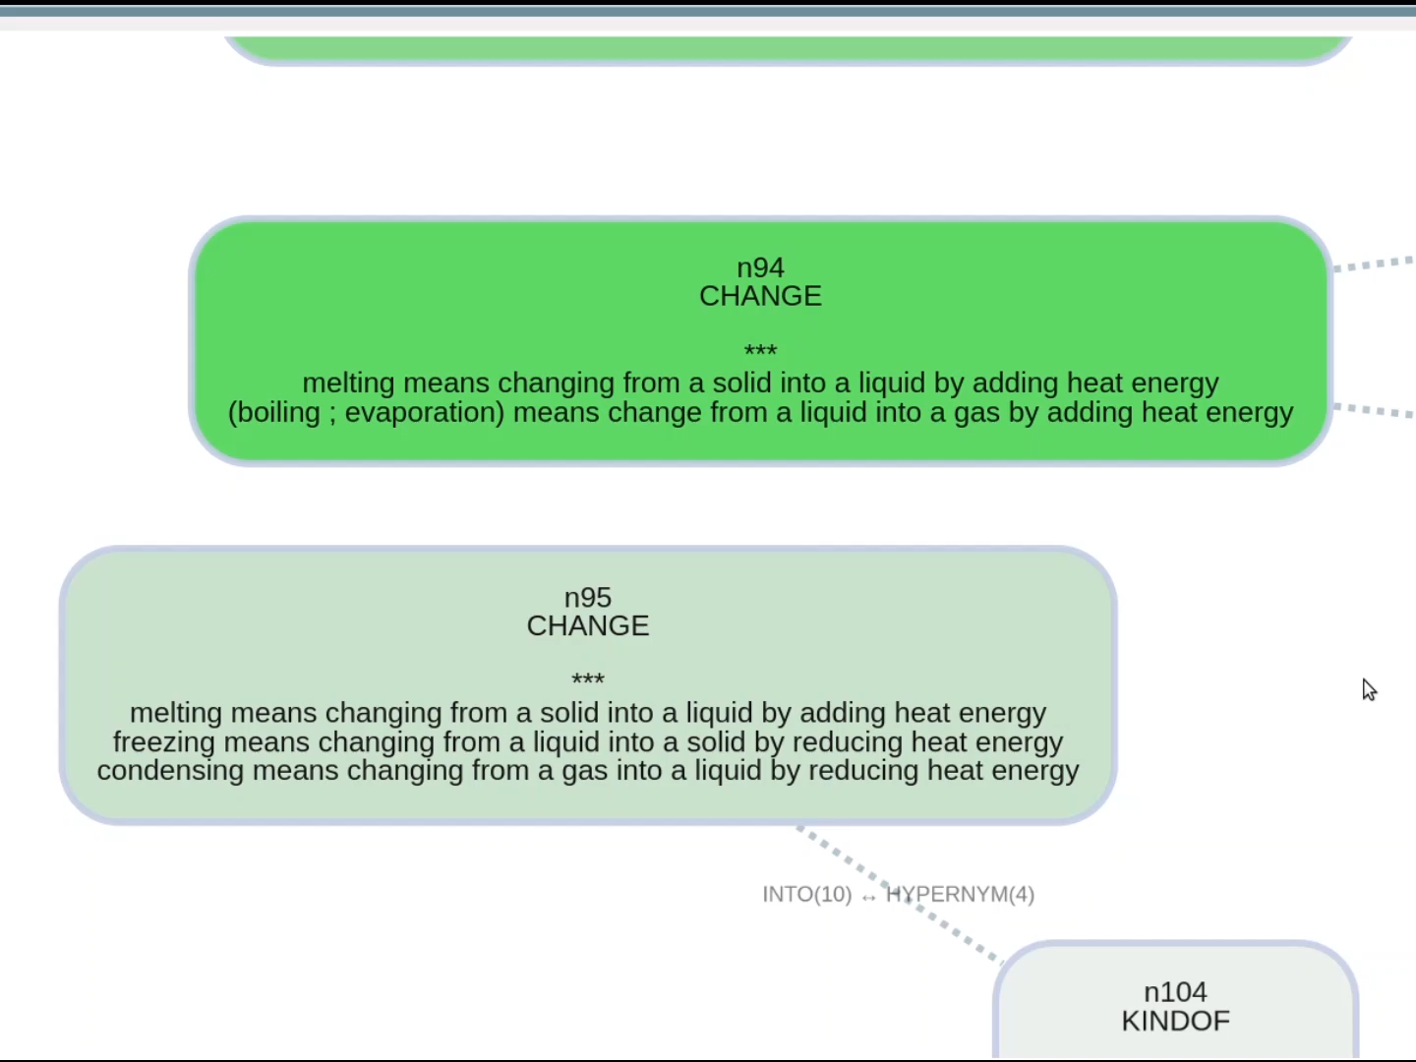
Notes:
We start out with two nodes on the graph
Both talking about different phase changes: the first melting…boiling…
The second melting, freezing, condensing
<start>
We can merge these nodes together by simple dragging and dropping one on top of the other
After that we want to give a name to the node so that we understand its meaning throughout the process
Here we call this node phase changes
As the graph grows bigger we need ways of searching the space, one of these methods is to highlight nodes with shared facts
When we’re ready for the next round of nodes we load them into the environment and run a layout algorithm to organize our workspace
With the full suite of features the only thing left to do was to get to it.
Merging related nodes, breaking apart unrelated nodes, and labeling the semantics
The work was pretty clear, and even fun to do at some points
Eventually when all the nodes and edges have been visited we end up
With the deeply connected graph of inference that I showed you on the previous slide…
So. What did we get from all this

Slide 19
Results
From a subset of 43 questions classified as “Matter” ¹ in the WorldTree explanation corpus ²
A set of 1680+ detailed explanations to questions from the ARC elementary science questions ³
We built a graph of 540 nodes and 771 edges
¹ Xu et al. 2019. Multiclass hierarchical question classification for multiple choice science exams.
² Jansen et al. 2018. Worldtree: A corpus of explanation graphs for elementary science questions supporting multi-hop inference. LREC-2018.
³ Clark. 2015. Elementary school science and math tests as a driver for AI: take the aristo challenge! In Proceedings of the Twenty-Ninth AAAI Conference on Artificial Intelligence
Notes:
From the World tree explanation corpus we experimented on a subset of 43 questions classified as having to do with Matter:
things like Change of State, Measuring Properties of Matter, or Physical Changes
After using he tool on the those questions we end up with a graph of 540 nodes and 771 edges

Slide 20
Results
From a subset of 43 questions classified as “Matter” ¹ in the WorldTree explanation corpus ²
A set of 1680+ detailed explanations to questions from the ARC elementary science questions ³
We built a graph of 540 nodes and 771 edges
67 patterns were extracted
29 of them high-level
+38 extracted from the high level patterns
¹ Xu et al. 2019. Multiclass hierarchical question classification for multiple choice science exams.
² Jansen et al. 2018. Worldtree: A corpus of explanation graphs for elementary science questions supporting multi-hop inference. LREC-2018.
³ Clark. 2015. Elementary school science and math tests as a driver for AI: take the aristo challenge! In Proceedings of the Twenty-Ninth AAAI Conference on Artificial Intelligence
Notes:
From the graph we extracted
67 patterns in total
29 of these patterns were high-level and identify main curricular concepts found in the corpus
From those 29 within these we extracted another 38 smaller patterns
Lets take a look at some of the high level patterns now

Slide 21
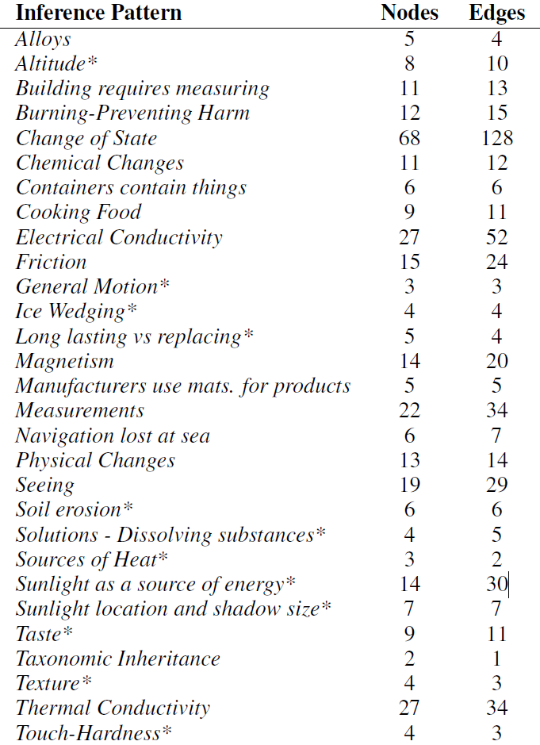
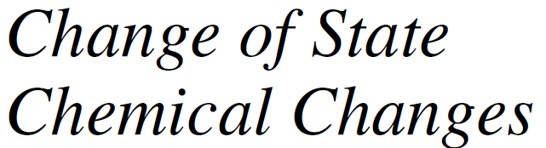
Notes:
Here we see patterns ranging from core scientific concepts like “Change of State”
to patterns that exhibit common sense information such as ‘Sunlight Location and Size,’ ‘people see things with their eyes
These concepts are abundant in the WorldTree Explanations since the corpus was designed to be meaningful to a 5 year old child
As a result, se see them here in our patterns

Slide 22
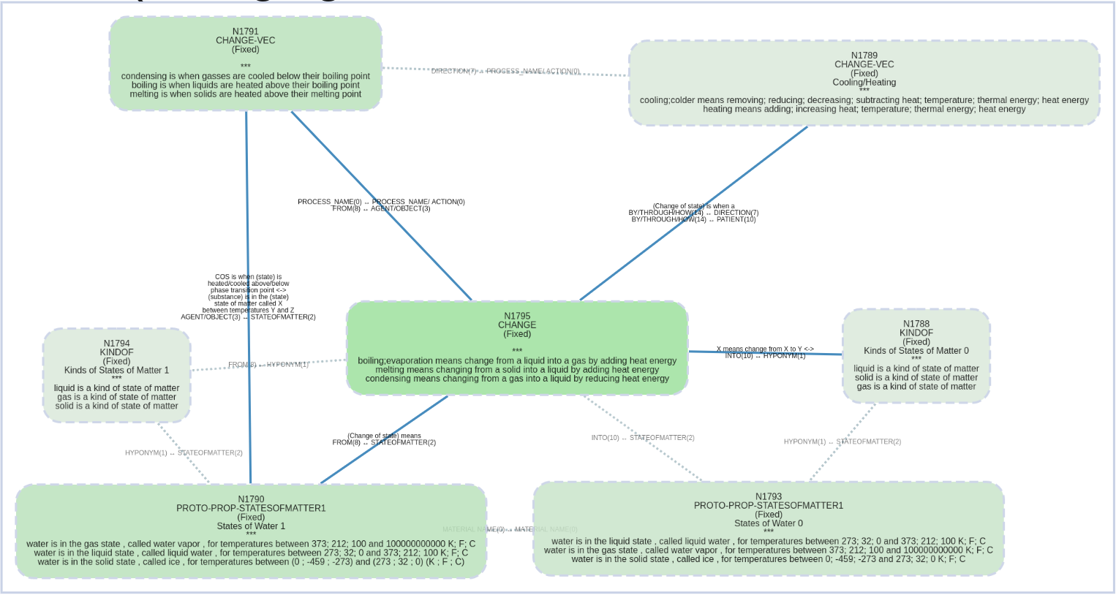
Change of State
Notes:
Going back to our toy example from the beginning we see a little more complexity in reality.
real explanations can be rather detailed, so our patterns pack a lot of information
This information builds a story

Slide 23
Phase Change Points
Change of State
Cooling / Heating
Initial State of Matter
Final State of Matter
Phase Changes
Initial
State of Water
Final
State of Water
Notes:
We have water in one state of matter being either cooled or heated past some phase changing point, changing it into some other state of matter.
In this way the narrative of a pattern can be read, but let us remind ourselves that the patterns can be used not just descriptively but also generatively

Slide 24
Change of State
[SoM_0]
[SoW_0] asdasdsadaddas
[COS] asdawdas
[SoM_1]
[SoW_1] adasdasd
[Cool/Heat]
[COS_points]
A liquid is a kind of state of matter
Water is in the liquid state, called liquid water, for temperatures between 0C and 100C
Freezing means changing from a liquid to a solid by reducing heat energy
A solid is a kind of state of matter
Water is in the solid state, called ice, for temperatures between -273C and 0C
Cooling means reducing heat energy
Freezing is when liquids are cooled below freezing point
Notes:
Here we see our example coming to life to create a an explanatory set of facts that does not exist in the training data
These seven facts explain how and why water can become frozen into ice
<read some if time permits>
We can see the utility of these patterns already

Slide 25
What We Are Working on Now
Want to apply the patterns to Question Explanation Algorithms
Notes:
So where are we today
We would like to use these patterns in the automated explanation of science questions

Slide 26
What We Are Working on Now
Want to apply the patterns to Question Explanation Algorithms
Addressing the time investment (~2hs per pattern)
Notes:
But before doing that we needed to modify the protocol, because when you take into account the full task of curating the graph and extracting the patterns we’re sitting at about 2hrs per pattern with the tool in this paper
Now this may scale sub-linearly but in order to scale this to 1000s of question corpus we need some changes

Slide 27
What We Are Working on Now
Want to apply the patterns to Question Explanation Algorithms
Addressing the time investment (~2hs per pattern)
Our new approach (10-15min per pattern)
We are halfway done through the full corpus of 1000+ ARC elementary science questions
We plan to submit our results to LREC (Conference on Language Resources and Evaluation)
Notes:
Since writing this paper we have already begun making those changes and now we have a tool that is generating patterns at a rate of around 10-15min per pattern
That’s letting us scale on the order of 1000s of questions with only about a month of annotation
We are currently over halfway done with extracting patterns for the ARC elementary science questions,
and plan to submit our patterns to LREC at the end of the month

Slide 28
Links
The Data:
http://www.cognitiveai.org/explanationbank
Web-viewer for the graph:
http://www.cognitiveai.org/dist/coin2019-infpat-cytoview.html
Notes:
The paper and data are available on cognativeai.com
We have also built a web-viewer so that you guys can see the graphs and all the patterns we extracted from it
And that is also available on the website
Id be happy to answer any questions

